Slide 1

Notes:
Slide 1. Artwork follows the Rogo nine-slide composition published in Business Insider's Pitch Deck Library.

Slide 2

Notes:
Slide 2. Artwork follows the Rogo nine-slide composition published in Business Insider's Pitch Deck Library.

Slide 3
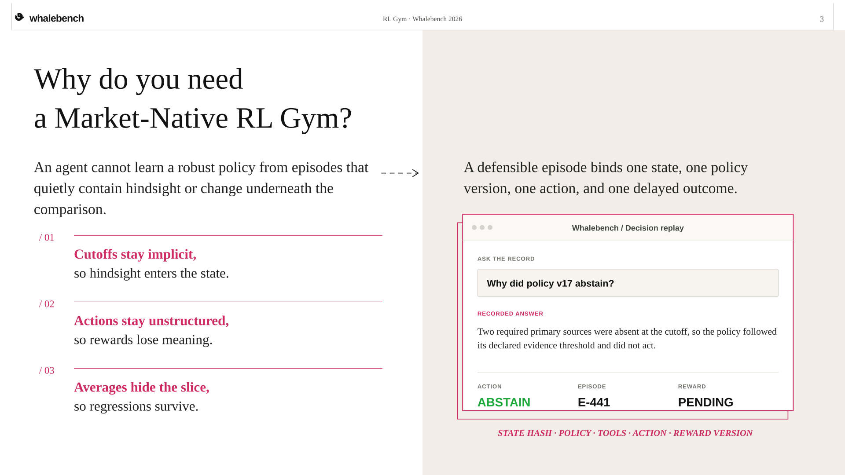
Notes:
Slide 3. Artwork follows the Rogo nine-slide composition published in Business Insider's Pitch Deck Library.

Slide 4
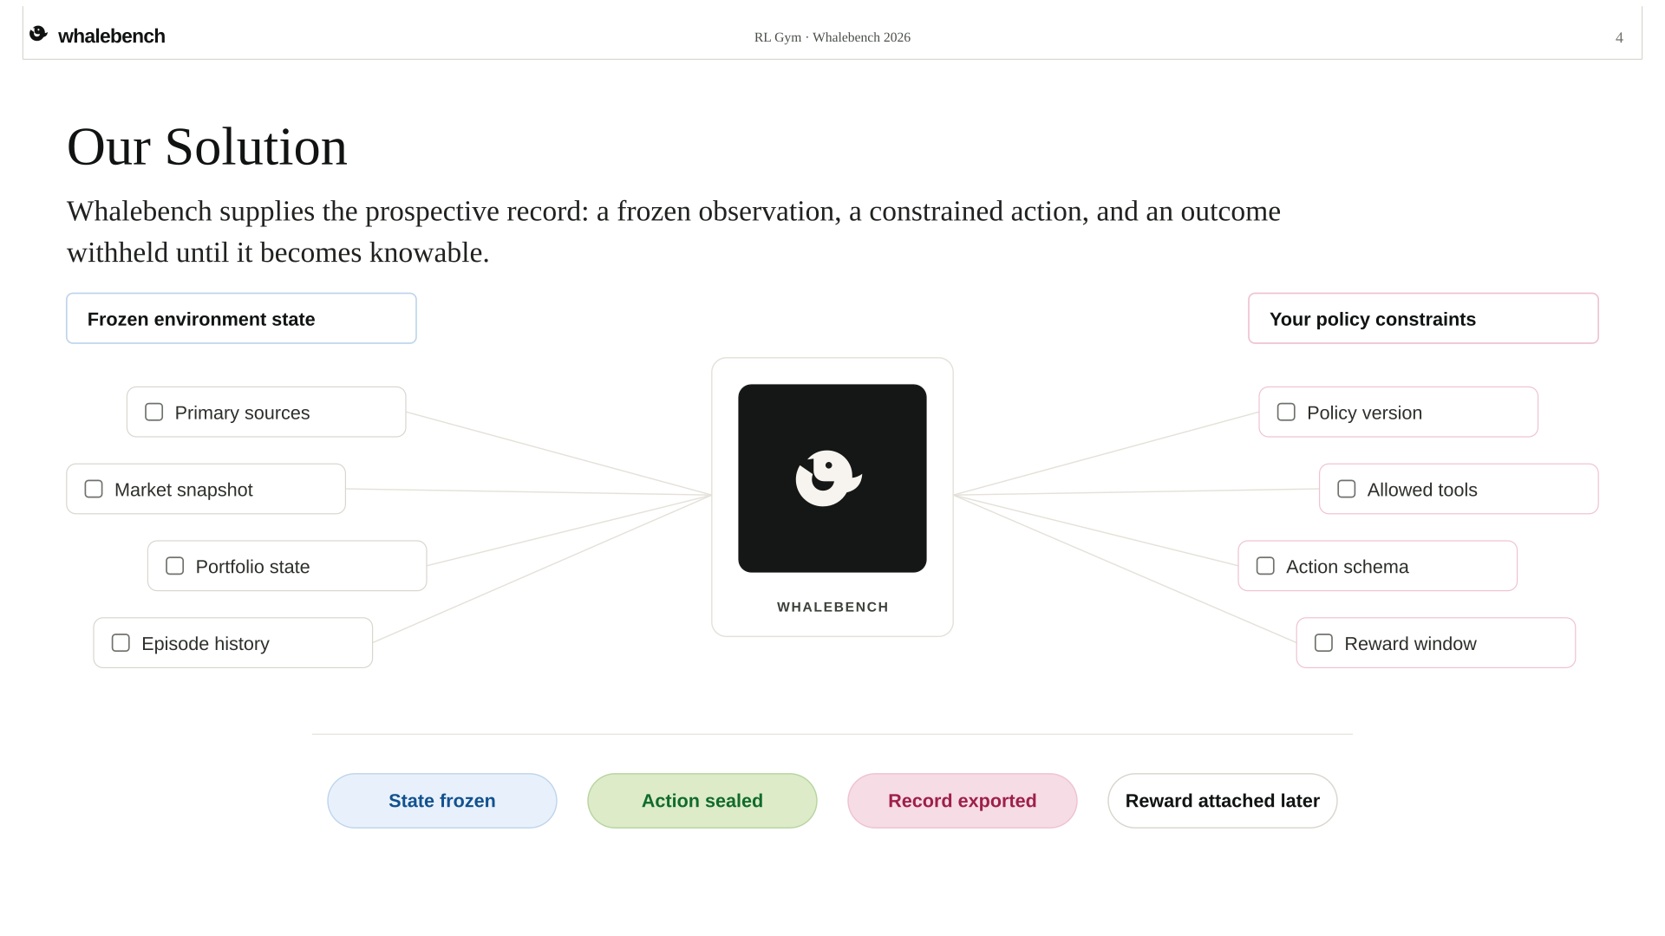
Notes:
Slide 4. Artwork follows the Rogo nine-slide composition published in Business Insider's Pitch Deck Library.

Slide 5
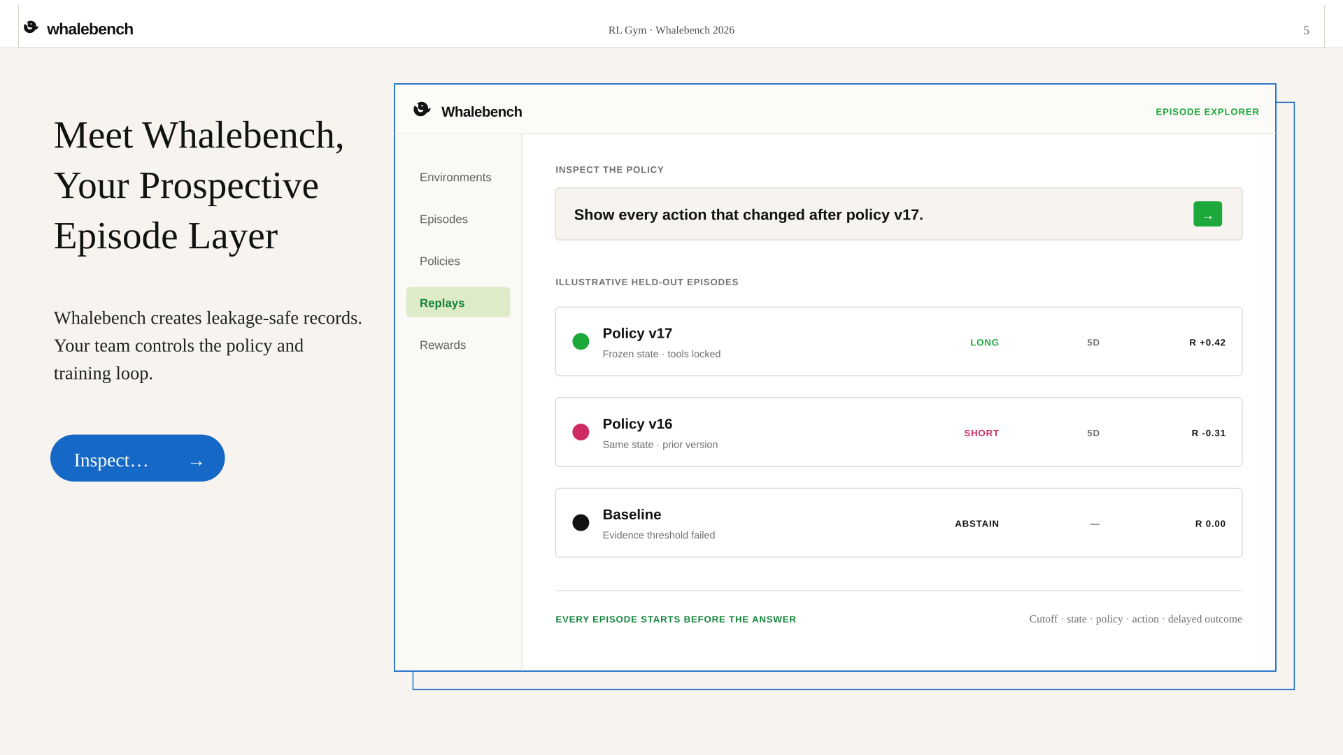
Notes:
Slide 5. Artwork follows the Rogo nine-slide composition published in Business Insider's Pitch Deck Library.

Slide 6
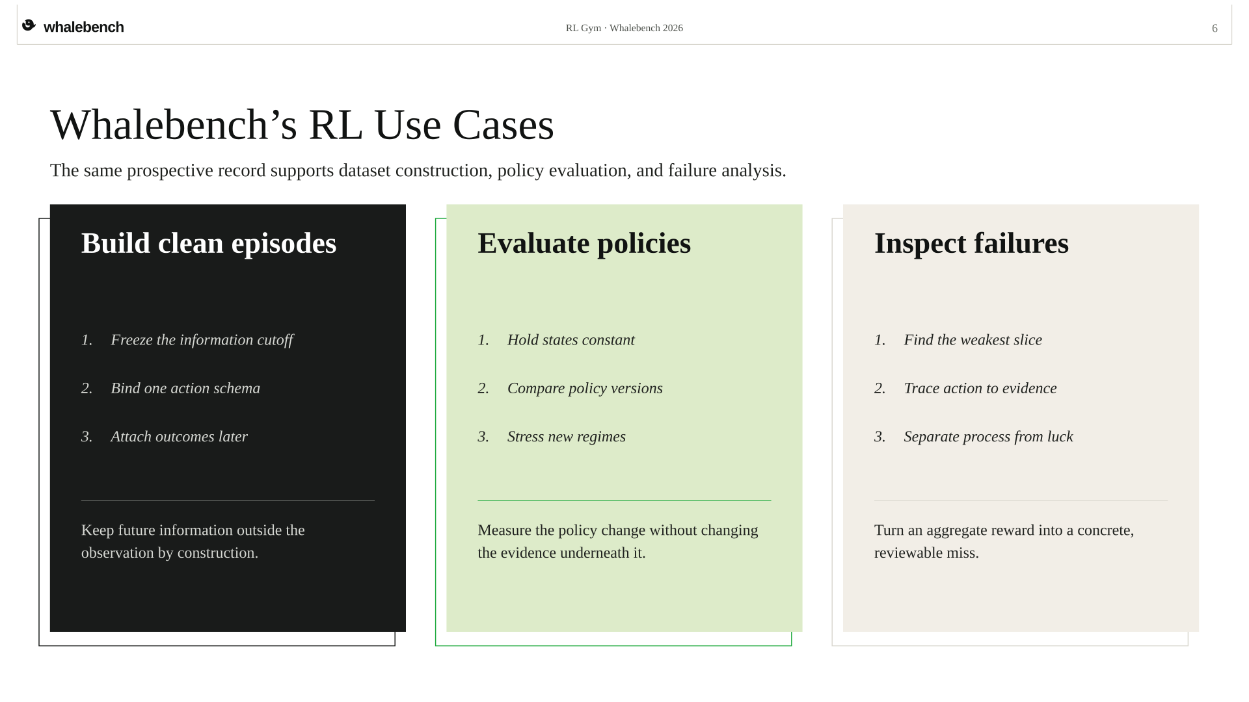
Notes:
Slide 6. Artwork follows the Rogo nine-slide composition published in Business Insider's Pitch Deck Library.

Slide 7
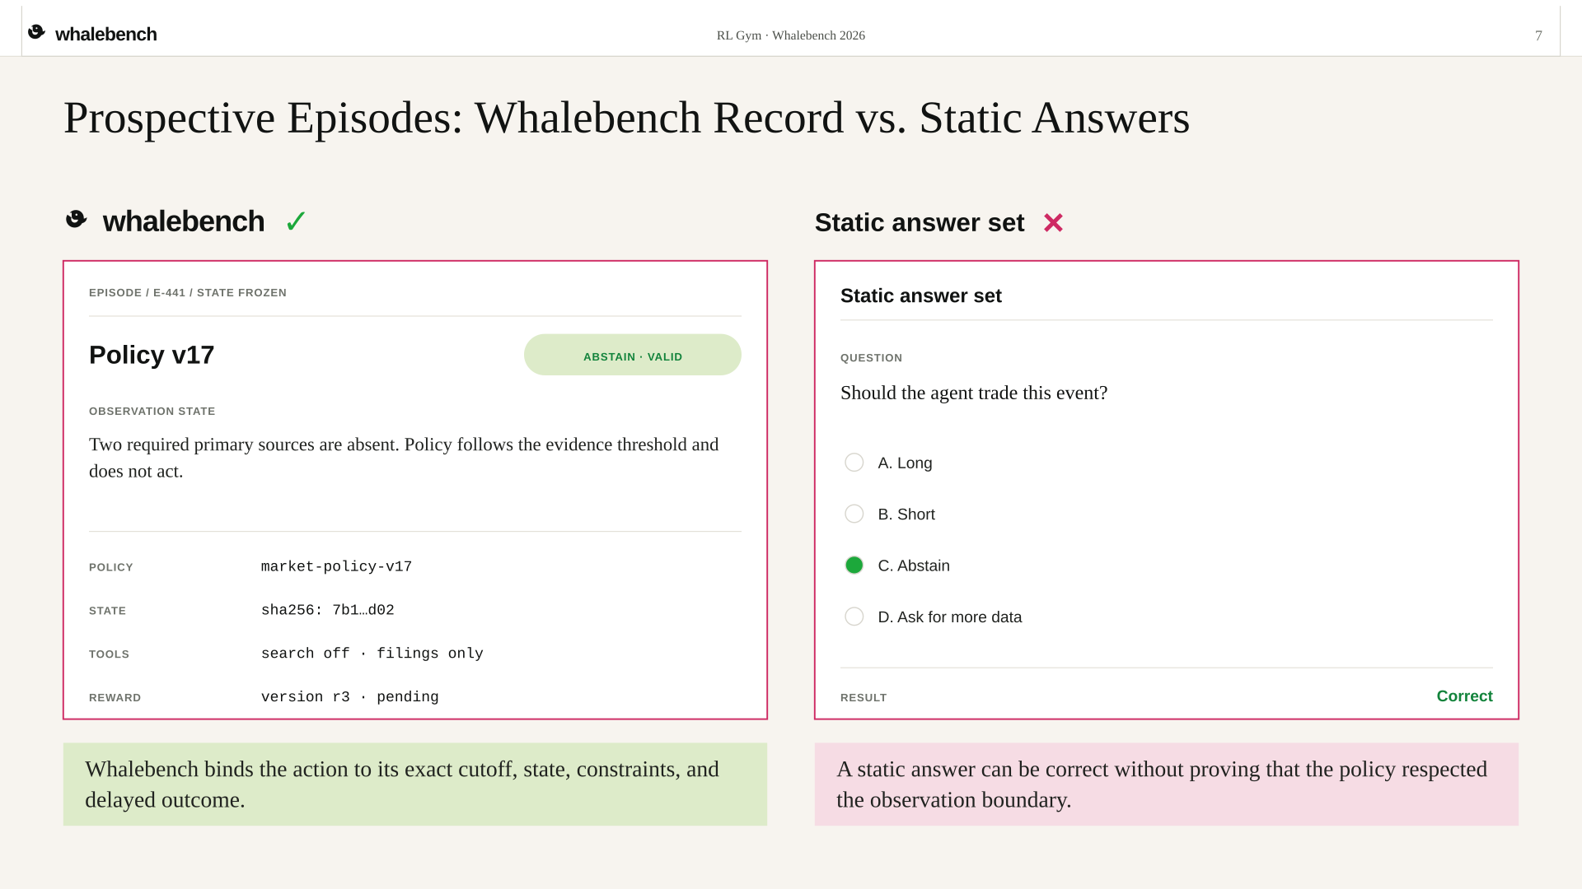
Notes:
Slide 7. Artwork follows the Rogo nine-slide composition published in Business Insider's Pitch Deck Library.

Slide 8
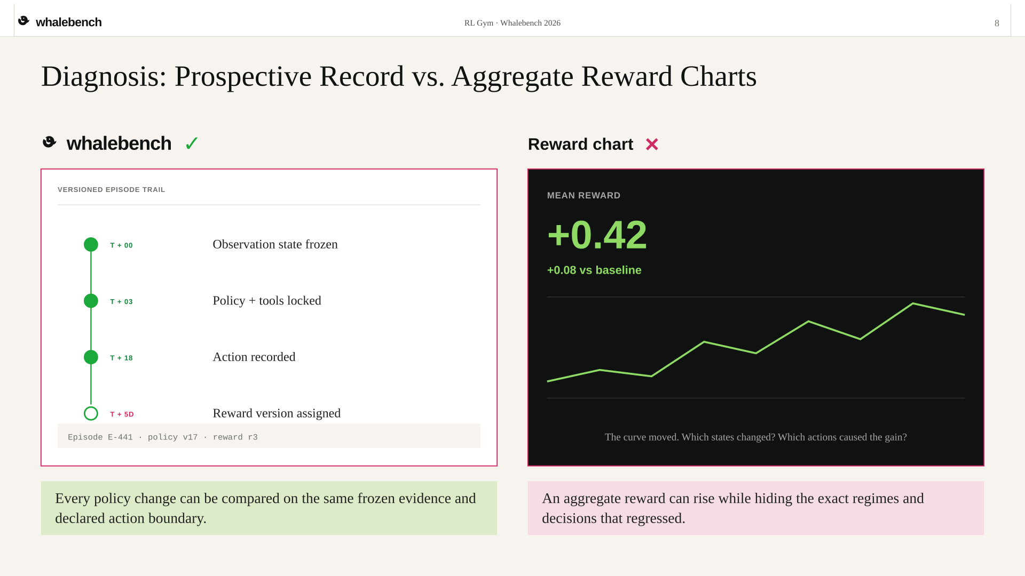
Notes:
Slide 8. Artwork follows the Rogo nine-slide composition published in Business Insider's Pitch Deck Library.

Slide 9

Notes:
Slide 9. Artwork follows the Rogo nine-slide composition published in Business Insider's Pitch Deck Library.

