Slide 1
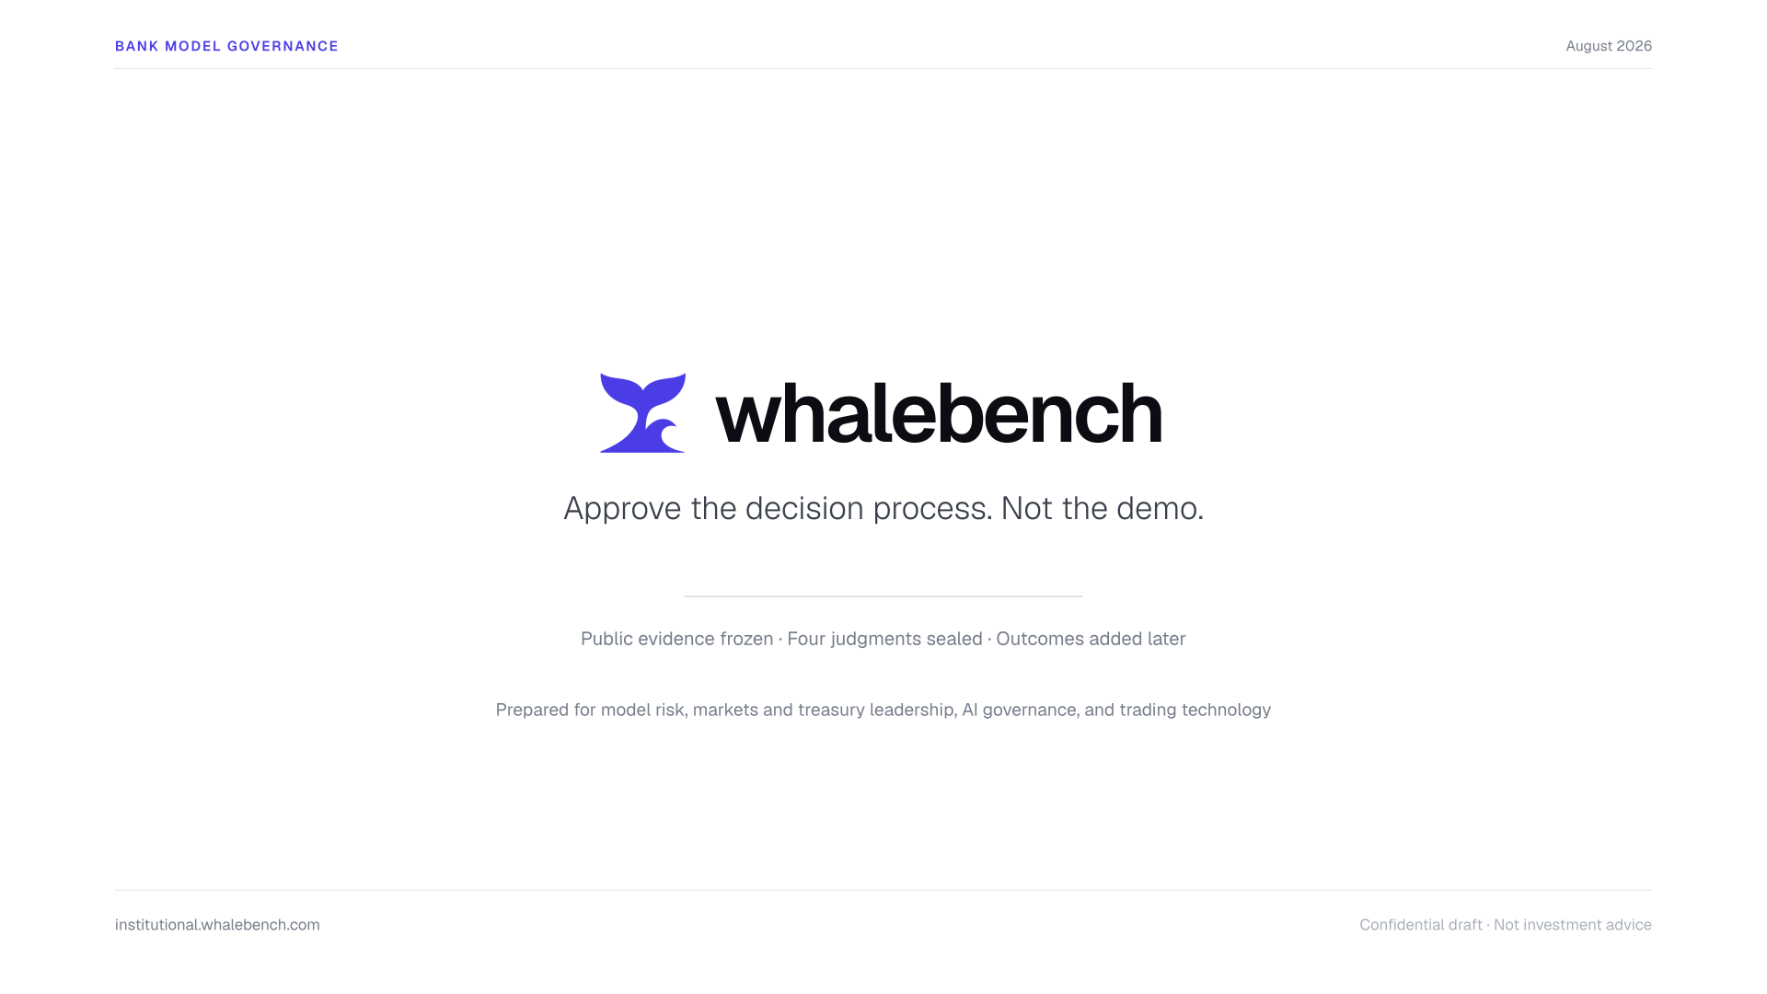
Notes:
Slide 1. Cover. Approve the decision process, not the demo.

Slide 2
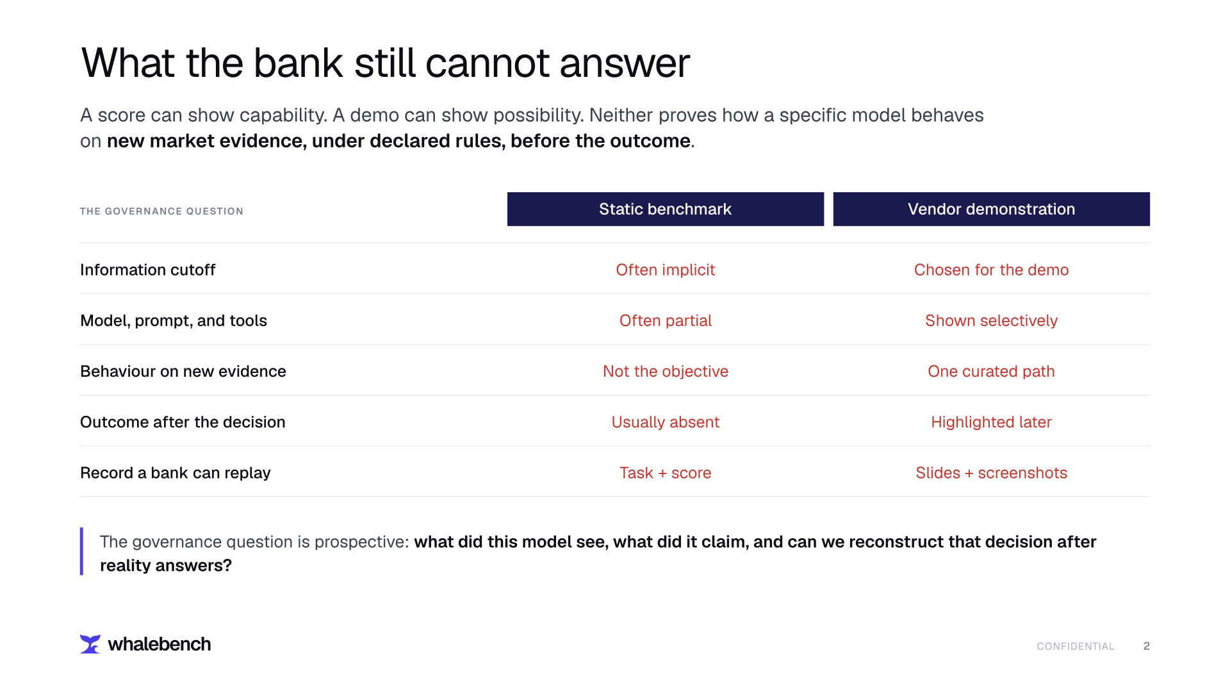
Notes:
Slide 2. The bank problem: scores and demos do not prove prospective behaviour on new market evidence.

Slide 3
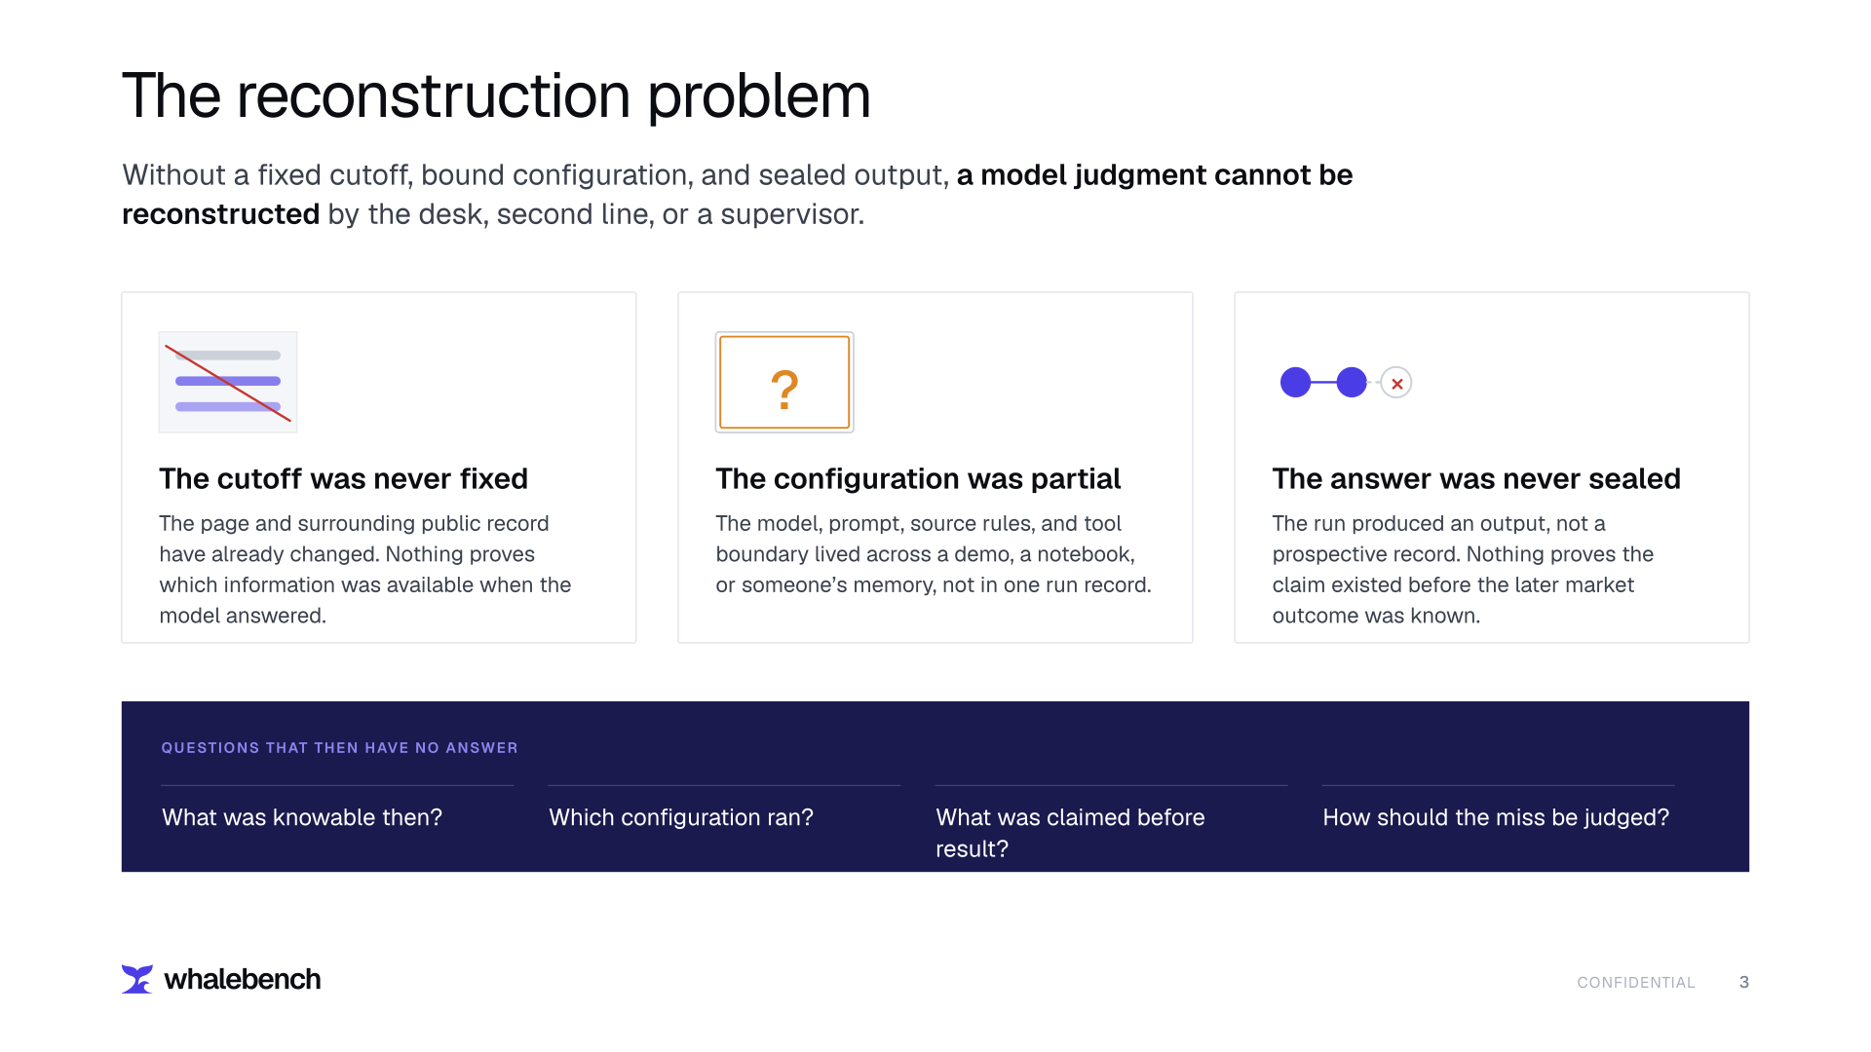
Notes:
Slide 3. Without a fixed cutoff, bound configuration, and sealed answer, a model judgment cannot be reconstructed.

Slide 4
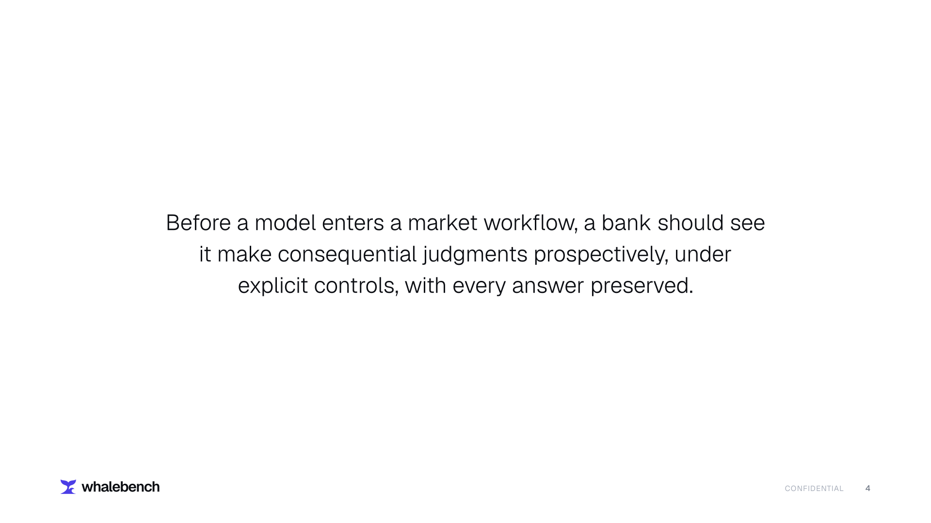
Notes:
Slide 4. Banks should observe consequential model judgment prospectively under explicit controls.

Slide 5
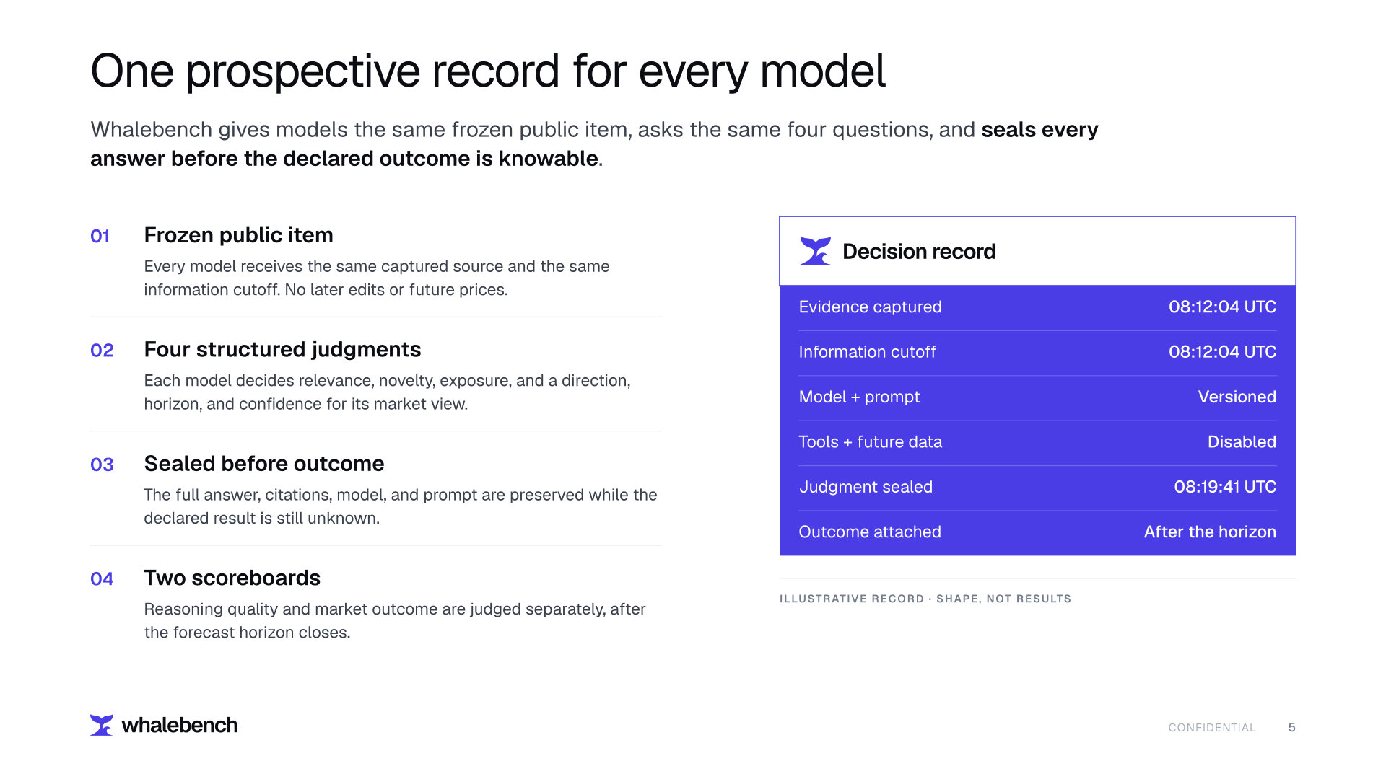
Notes:
Slide 5. Same frozen public item, four structured judgments, sealed answers, and separate reasoning and outcome scores.

Slide 6
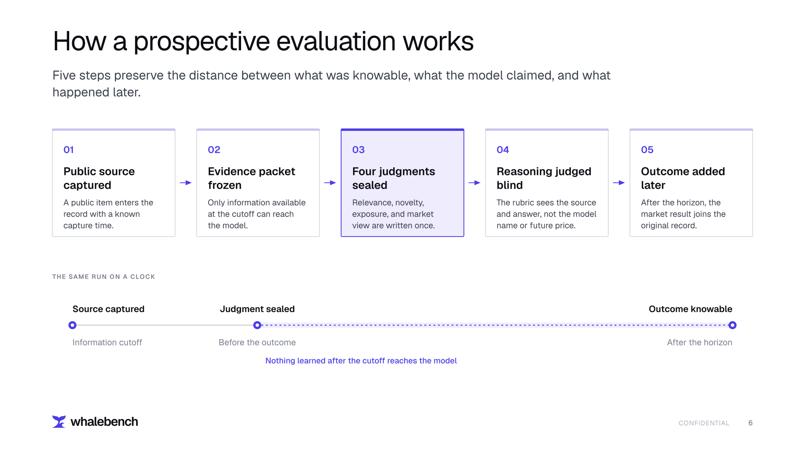
Notes:
Slide 6. Capture source, freeze evidence, seal four judgments, apply a blinded rubric, and attach outcome later.

Slide 7
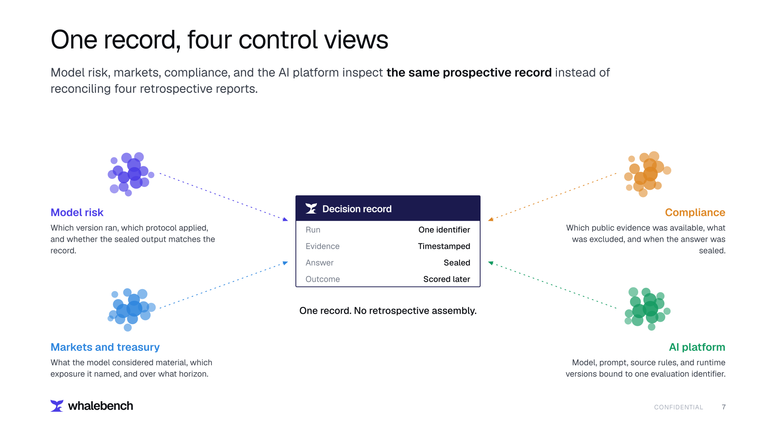
Notes:
Slide 7. Model risk, markets, compliance, and engineering inspect the same decision record.

Slide 8
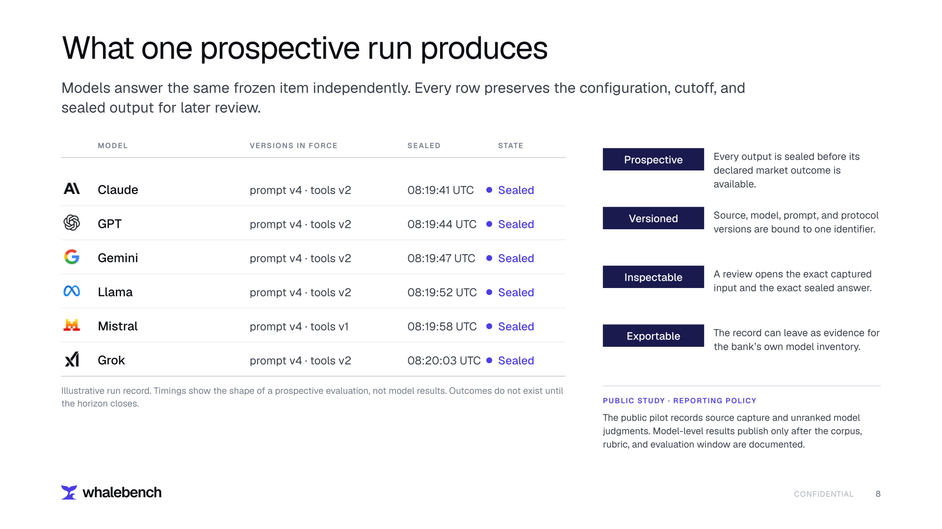
Notes:
Slide 8. Parallel model comparison with a prospective, versioned, inspectable, and exportable record.

Slide 9
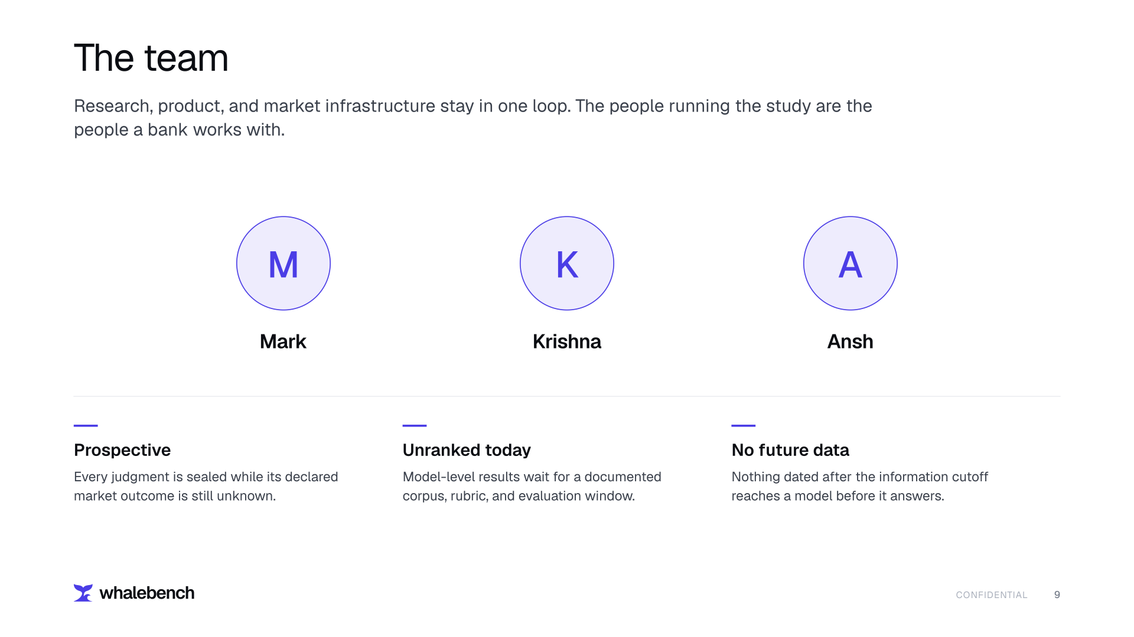
Notes:
Slide 9. Mark, Krishna, Ansh, and the standing constraints of the study.

Slide 10
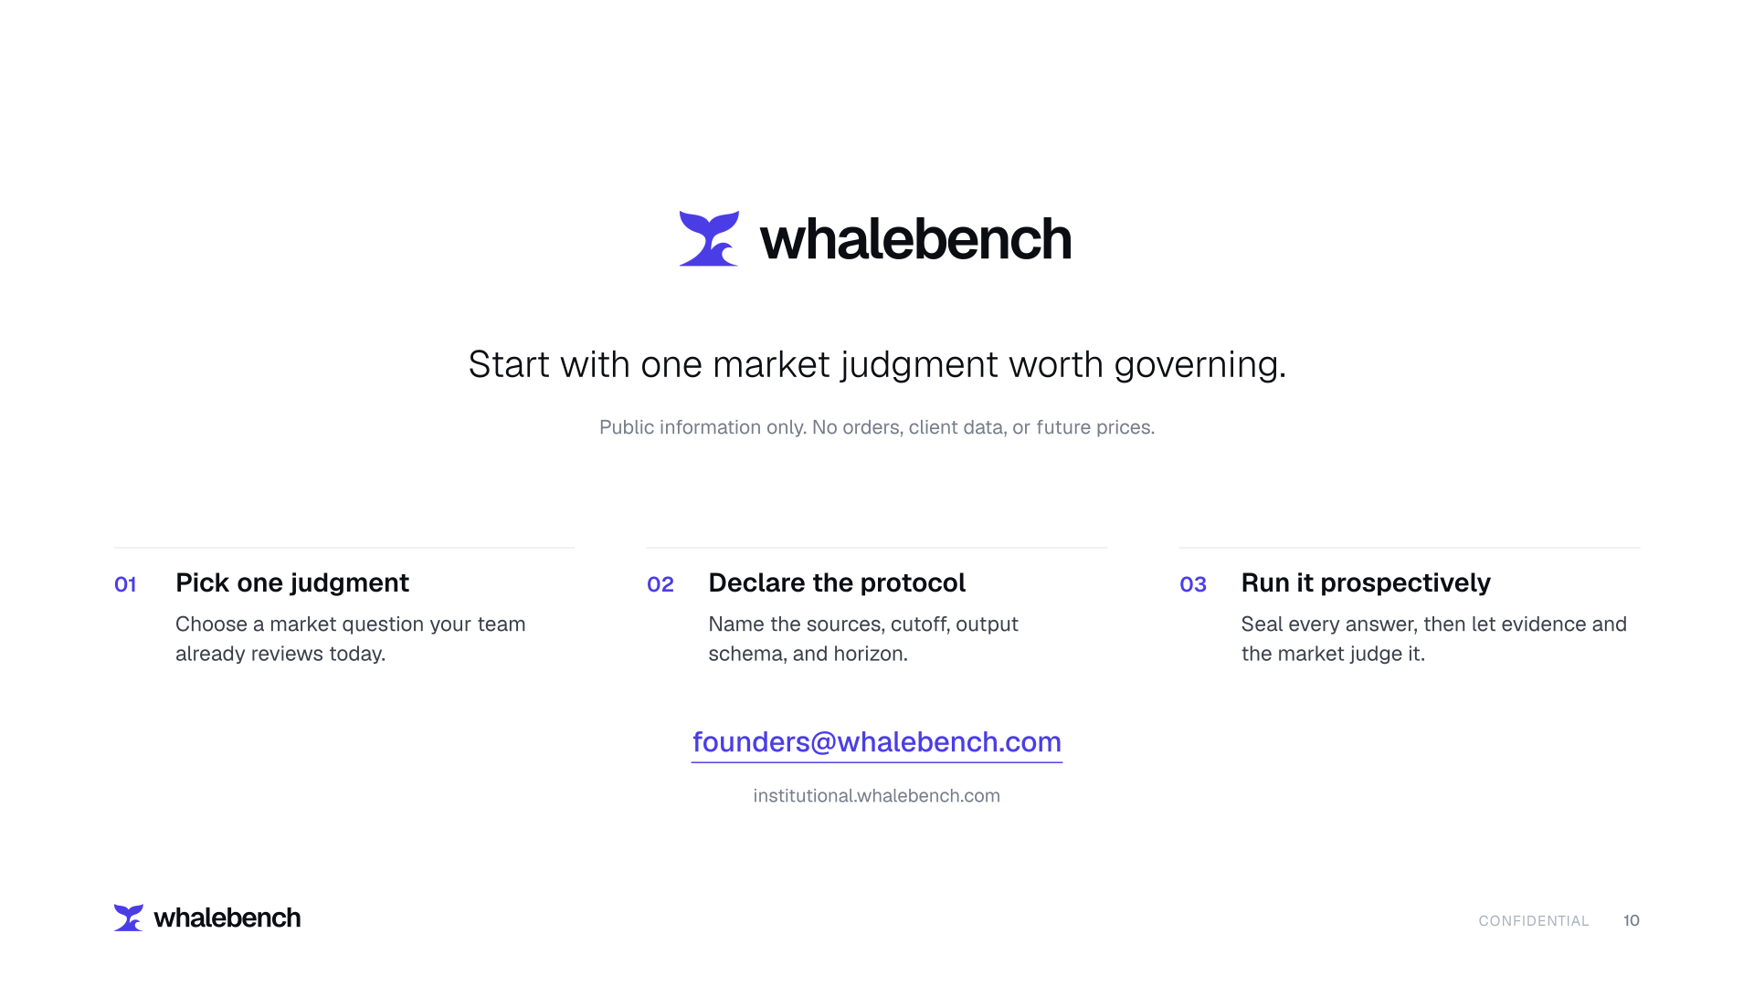
Notes:
Slide 10. Call to action for one prospective bank evaluation.

